Slide 1
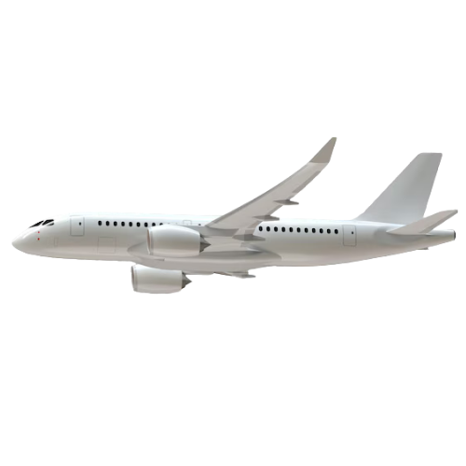
Airport Authority Data Analysis
Presented by: Muluwerk Derebe

Slide 2

Total number of flight
7
Millions
Flights
in total
& out of that
117K Canceled Flights

Slide 3
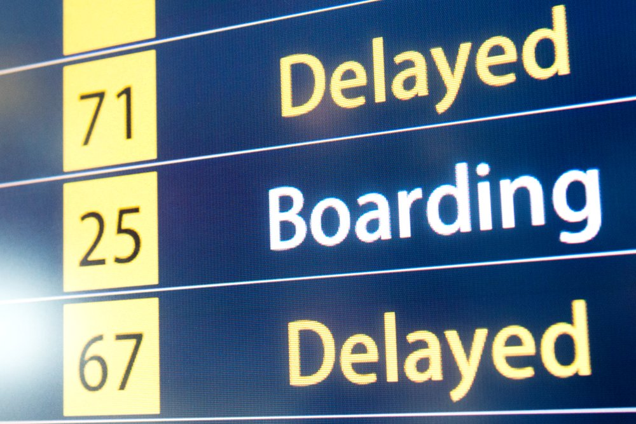
Total of flight delays
&
Arrivals
Departures
Departure delays:
Arrival delays:
2 M
3 M
Reasons:
1. Security 127K
2. Carrier 26M
3. Late-Aircraft 35M
4. NAS 21M
5. Weather 5M

Slide 4
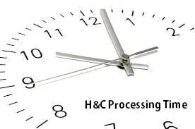
Ground Processing Time (GPT)
248M Minutes in Total

Slide 5

Passenger feedback
Strongly satisfied (63%)
4.6 M in total
Satisfied (16,79%)
1.2 M in total
Dissatisfied (18,15%)
1.3 M in total
Strongly dissatisfied (1,62%)
117k in total

Slide 6
Thank You !!!

